Slide 1
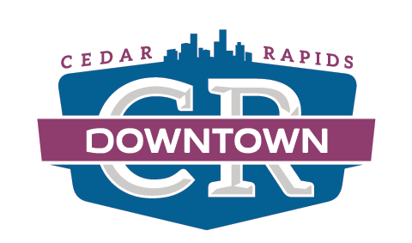
Downtown Self Supported Municipal Improvement District
2020 RECAP AND 2021 PLANS
Jesse Thoeming, Executive Director
March 25, 2021

Slide 2
2020

Slide 3
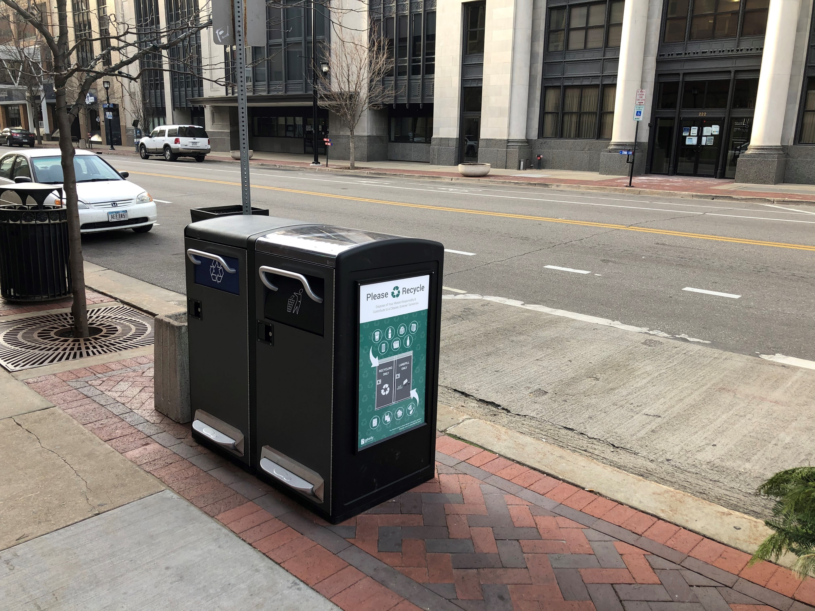
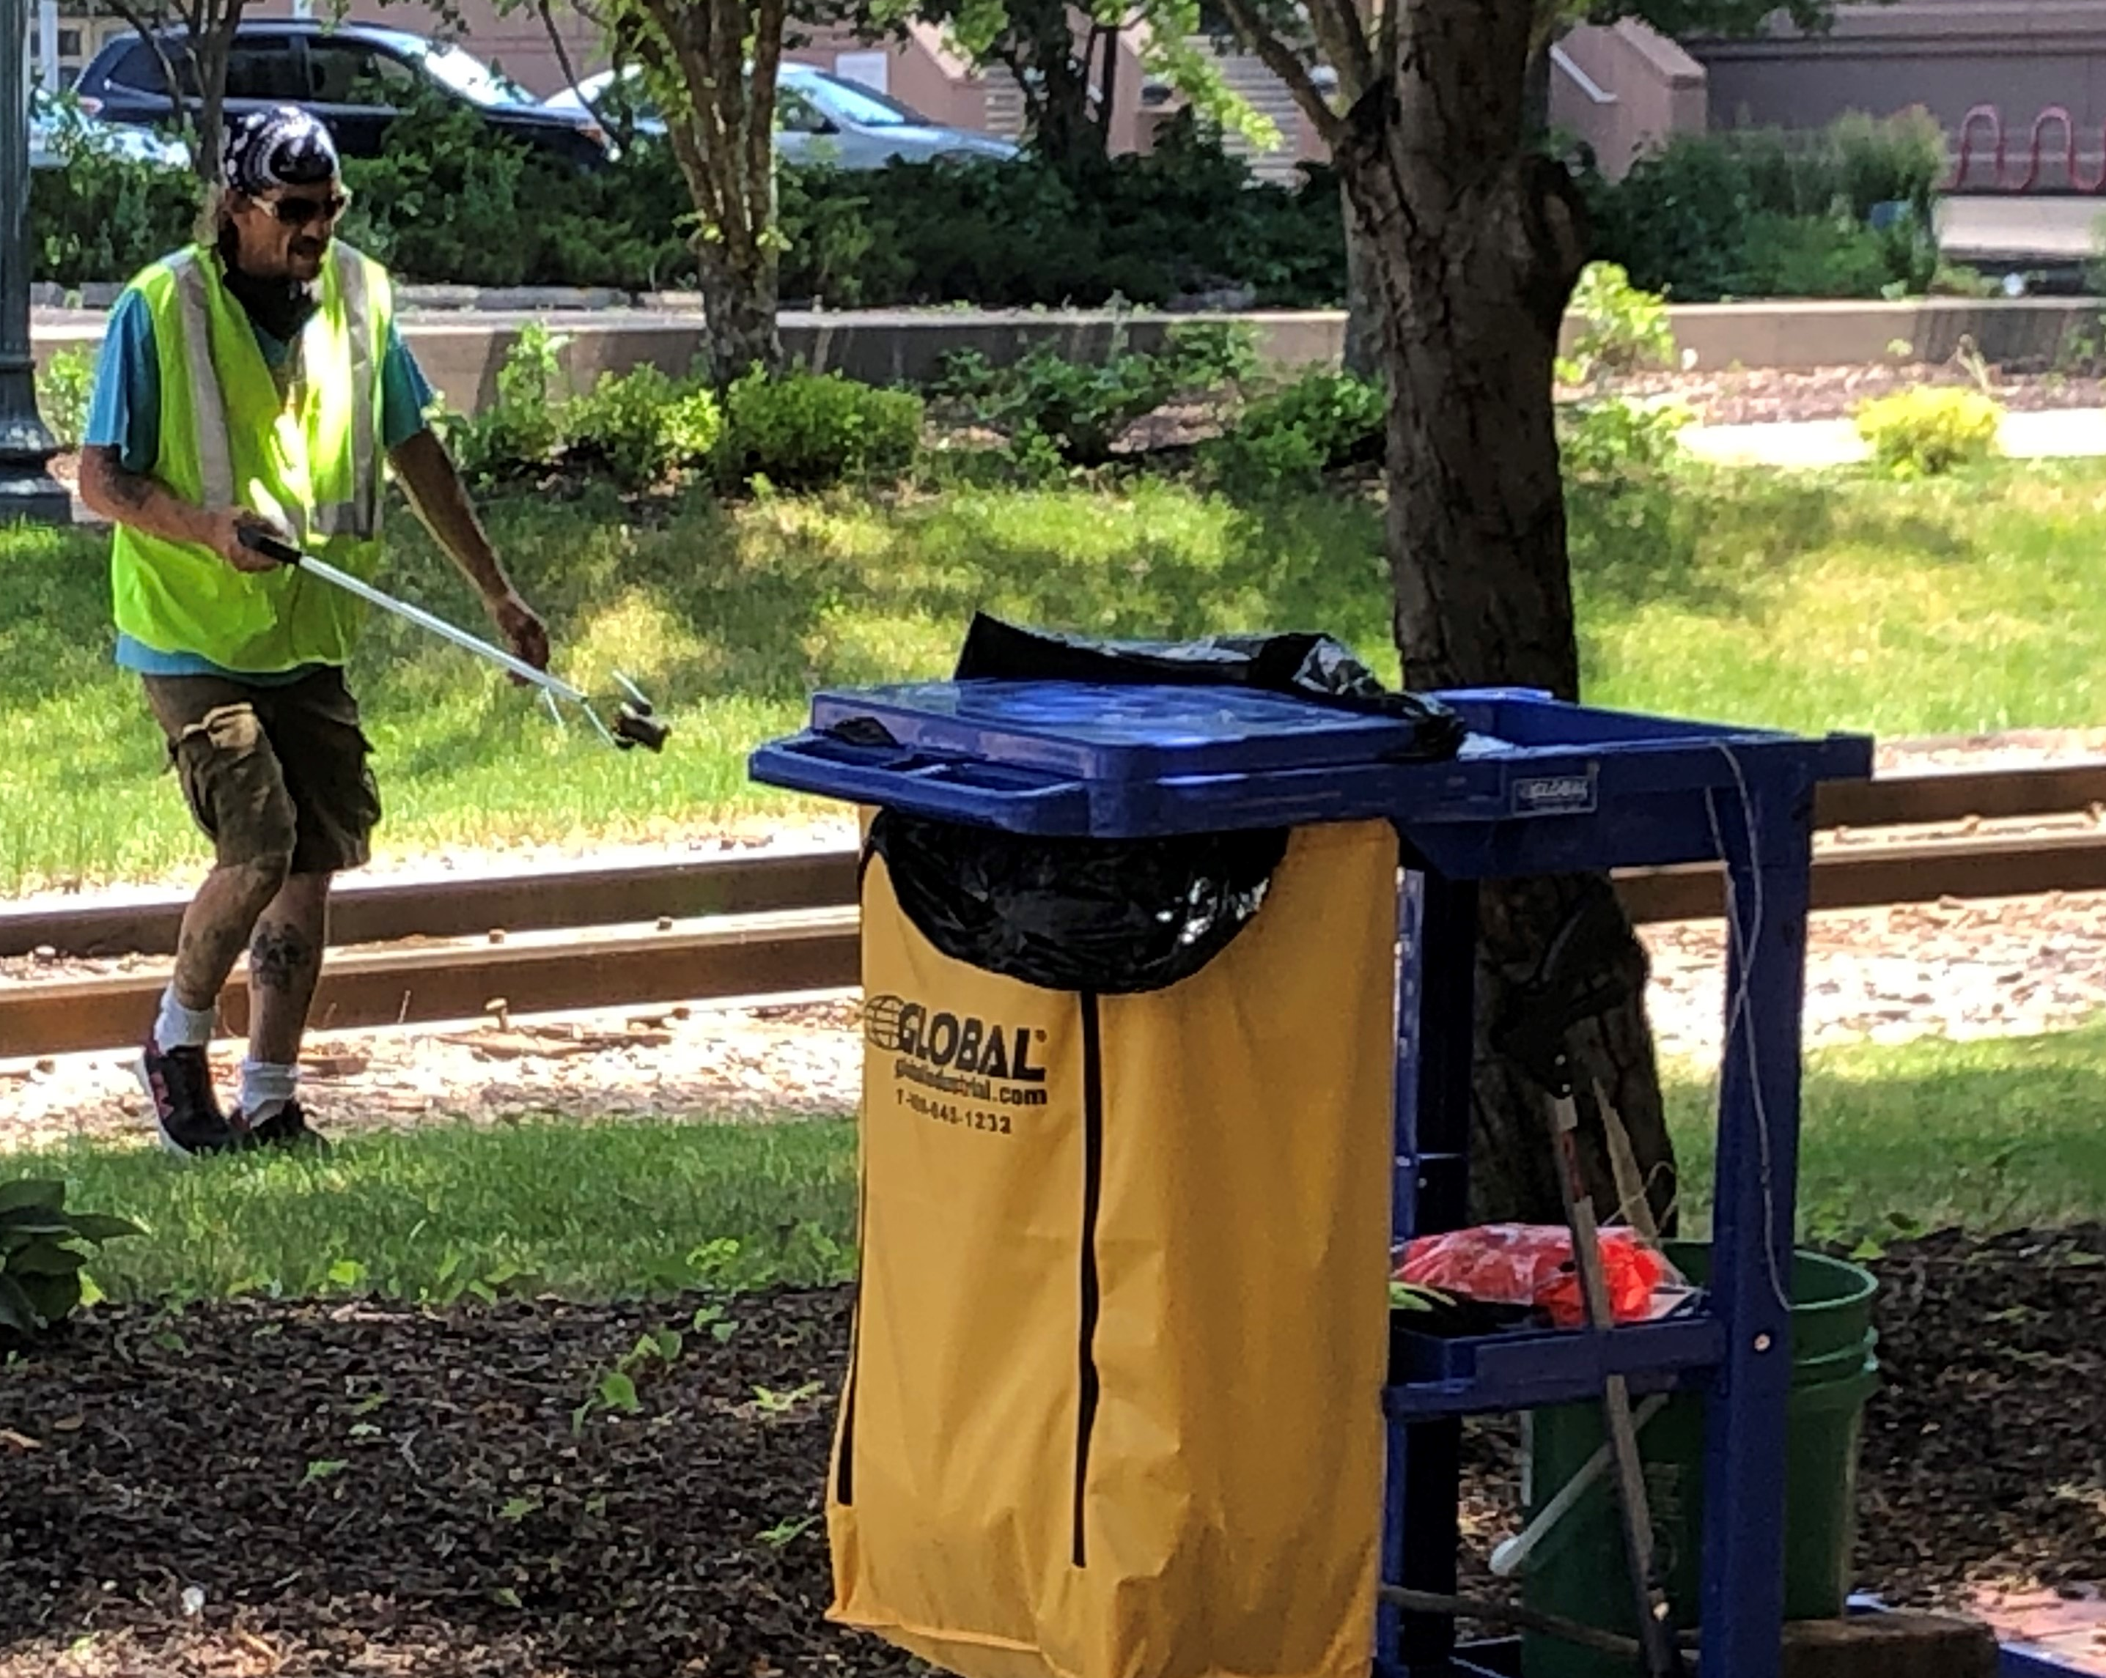
2020
Installed 20 Big Belly trash cans throughout Downtown
Partnership with Willis Dady to provide additional cleaning and upkeep services
Continue to sponsor Greene Square Ambassador program

Slide 4
2020
Downtown CR Dollars 2020/2021 Program
$150K in economic impact
Supporting 35 Downtown businesses
As of 3/22/21:
Total Approved Receipts: $98,711.59 (1,345 receipts)
Number of Participants: 345
Number of Gift Cards Mailed: 1,017 (worth $25,425)

Slide 5
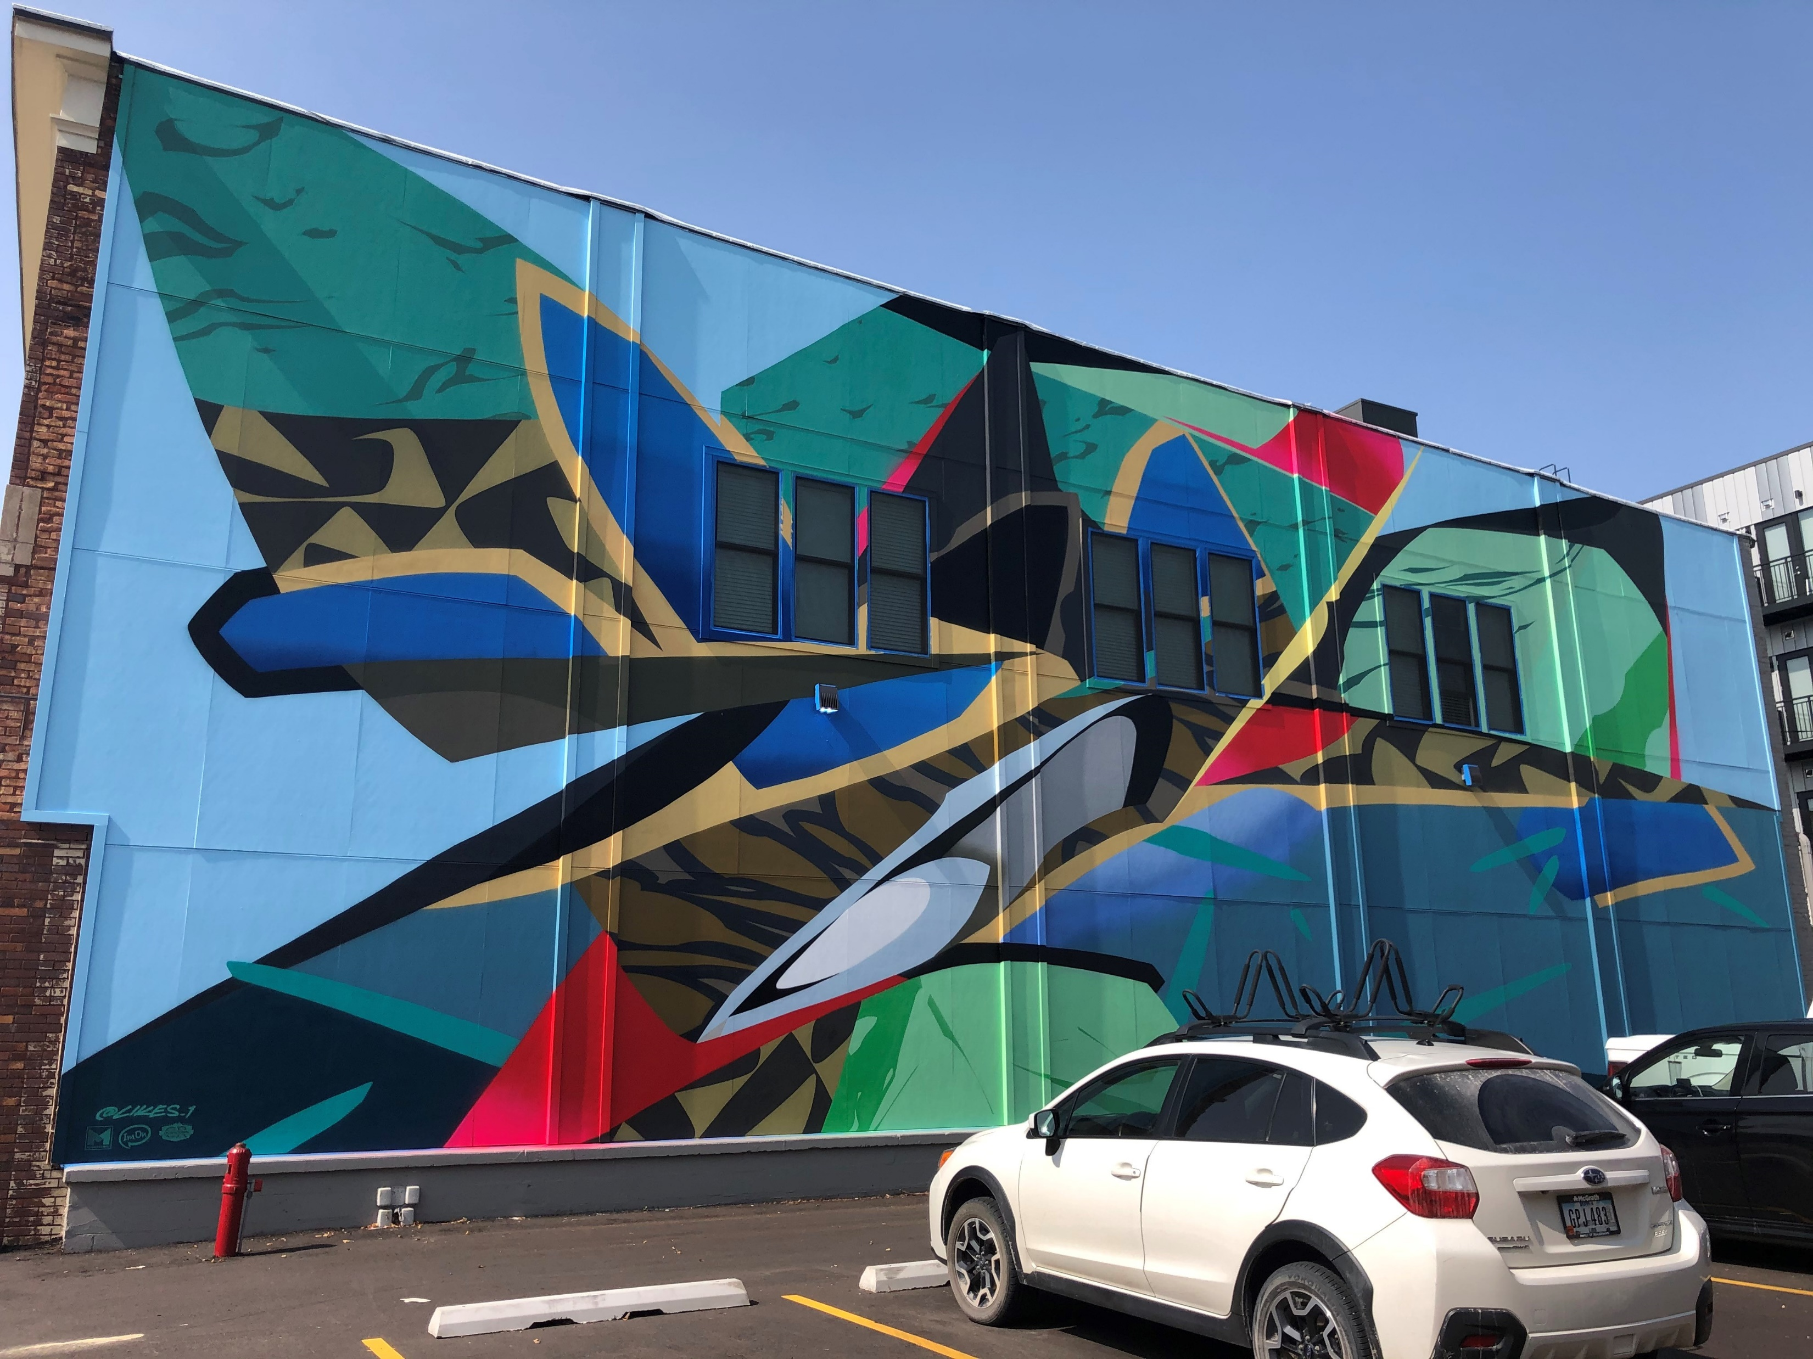
2020
Seed to Sky Mural

Slide 6
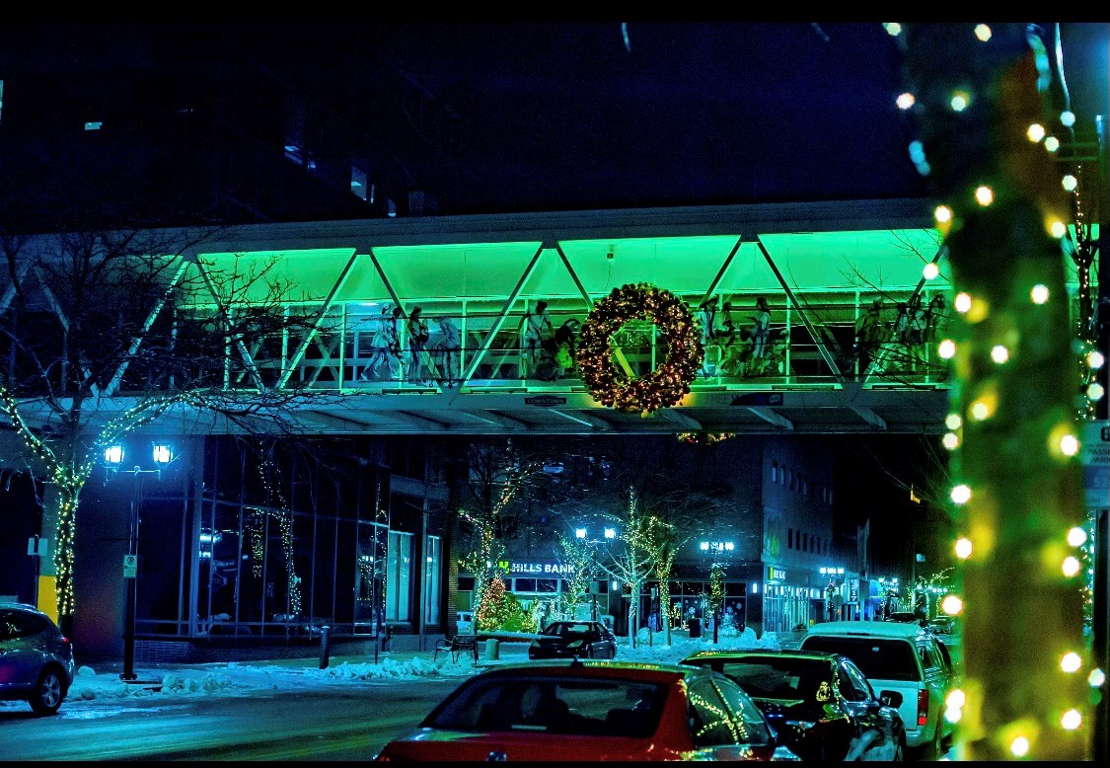
2020
District holiday lighting: will invest in one more round of new lights and décor to complete vision that was initiated during 2019 season and expanded last year

Slide 7
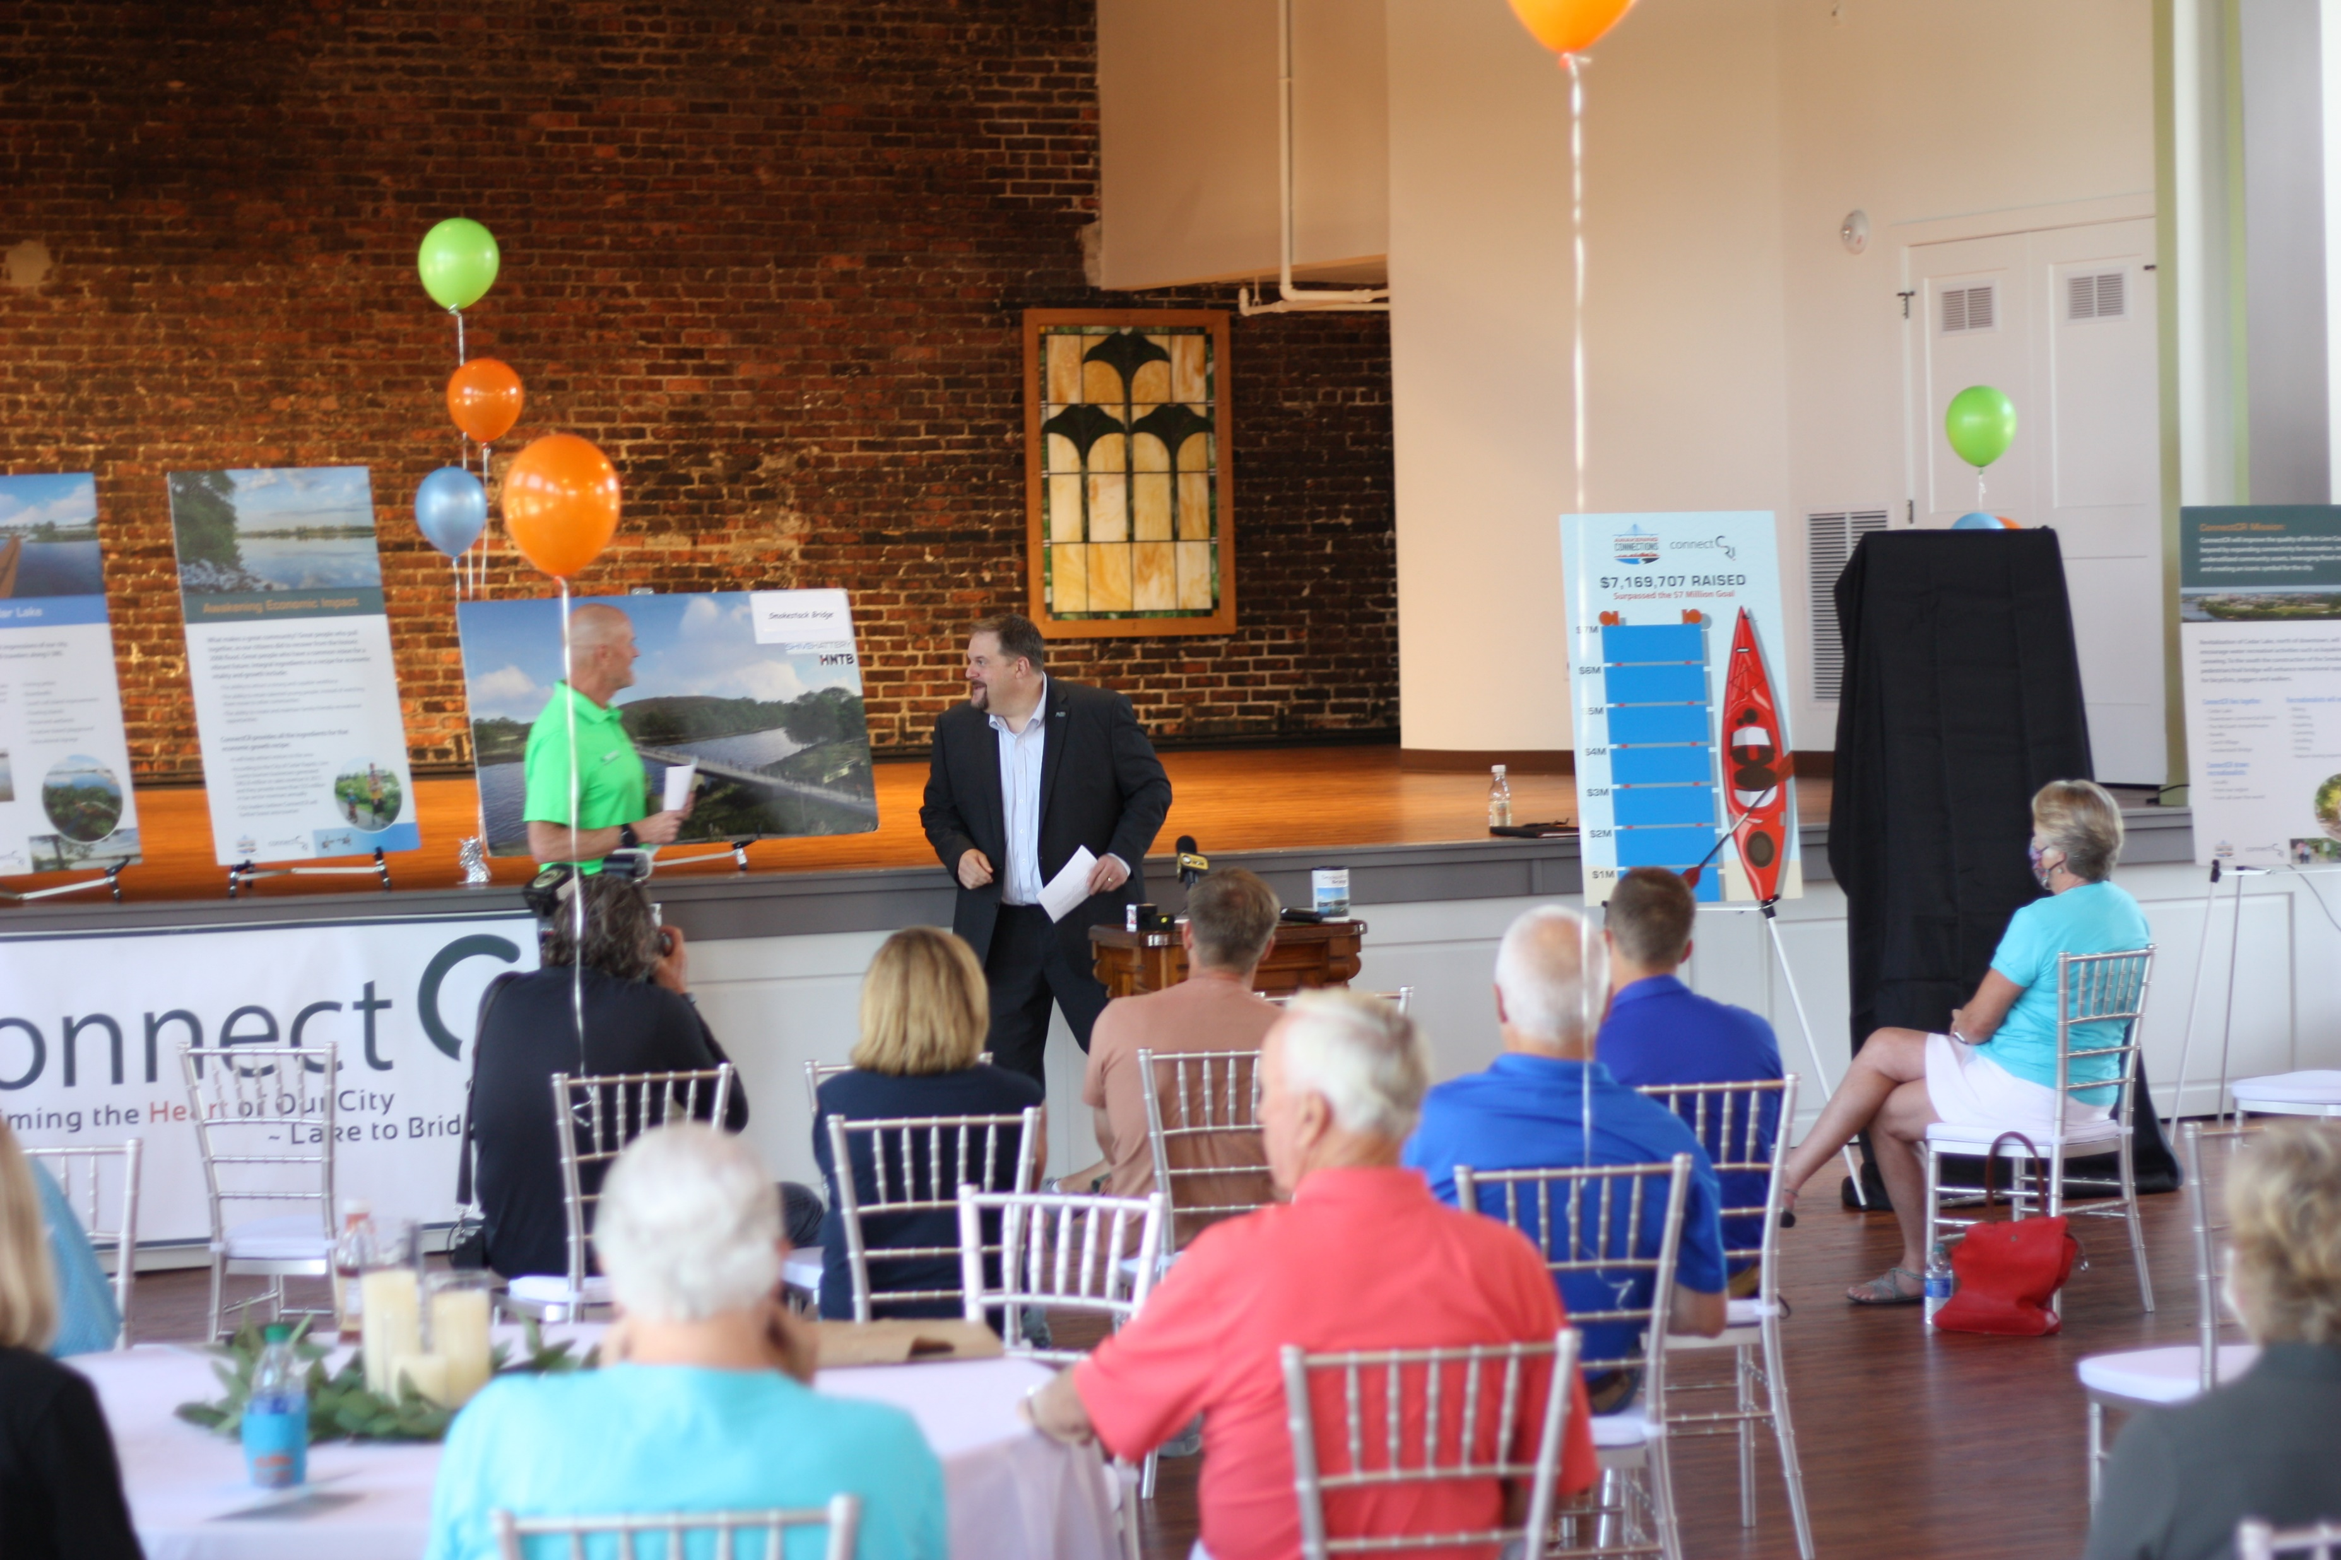
2020
Second year supporting ConnectCR (5-year pledge)

Slide 8
2021
Plans

Slide 9
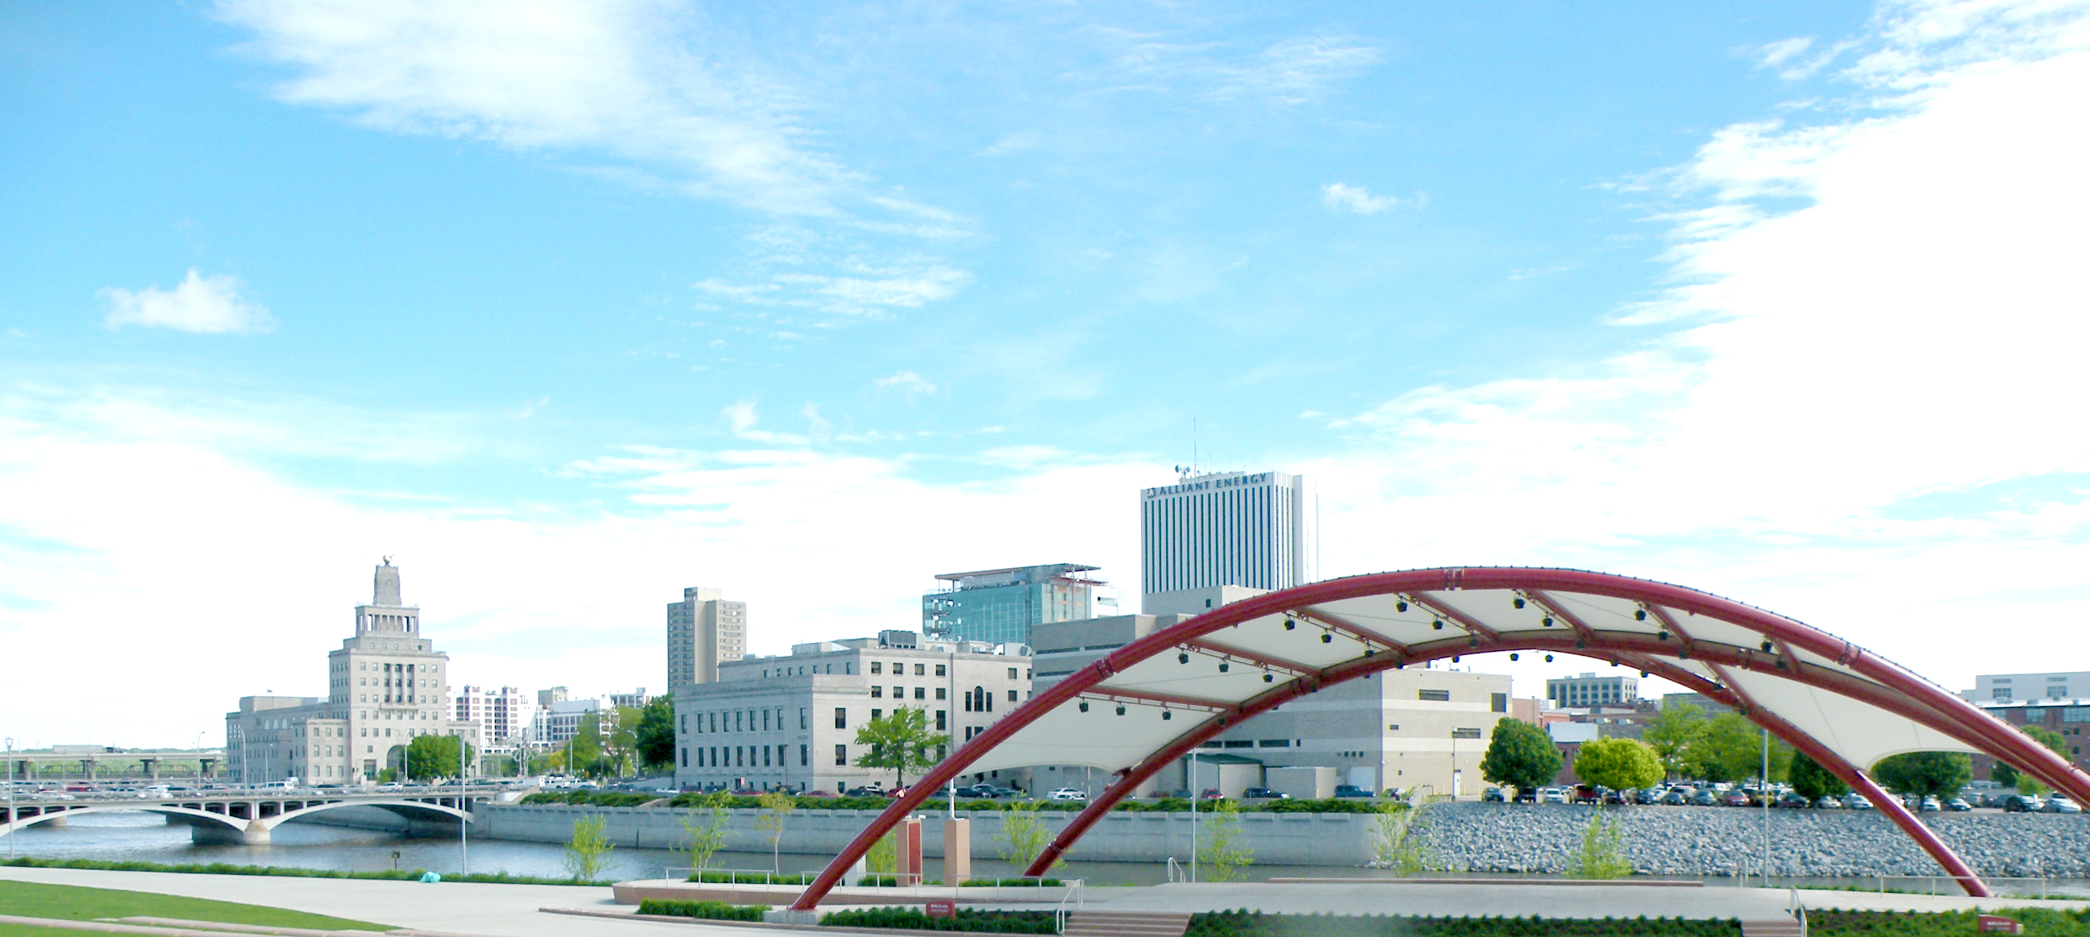
Plans
2021
New Downtown Brand
Experience Downtown, focus on micro districts e.g. McGrath, Greene Square, 3rd and 3rd, Riverfront
Project includes new signage & wayfinding, banners, welcome signs, district frames, skywalk signs, business roll out, and public launch
Potential unveil at first Downtown Farmers Market (Saturday June 19)

Slide 10
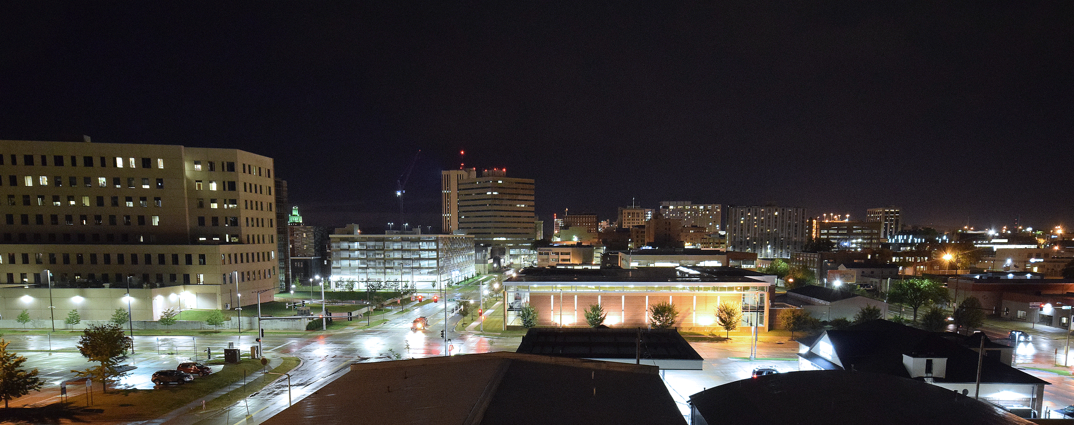
Plans
2021
Downtown Gateways
Partnership with City, MedQ, and I-Dot
5 locations for signature gateways identified by most recent JLG Vision Plan
Current focus is on 7th Street area
Working with Confluence to define specific vision prior to submitting plan to I-DOT

Slide 11
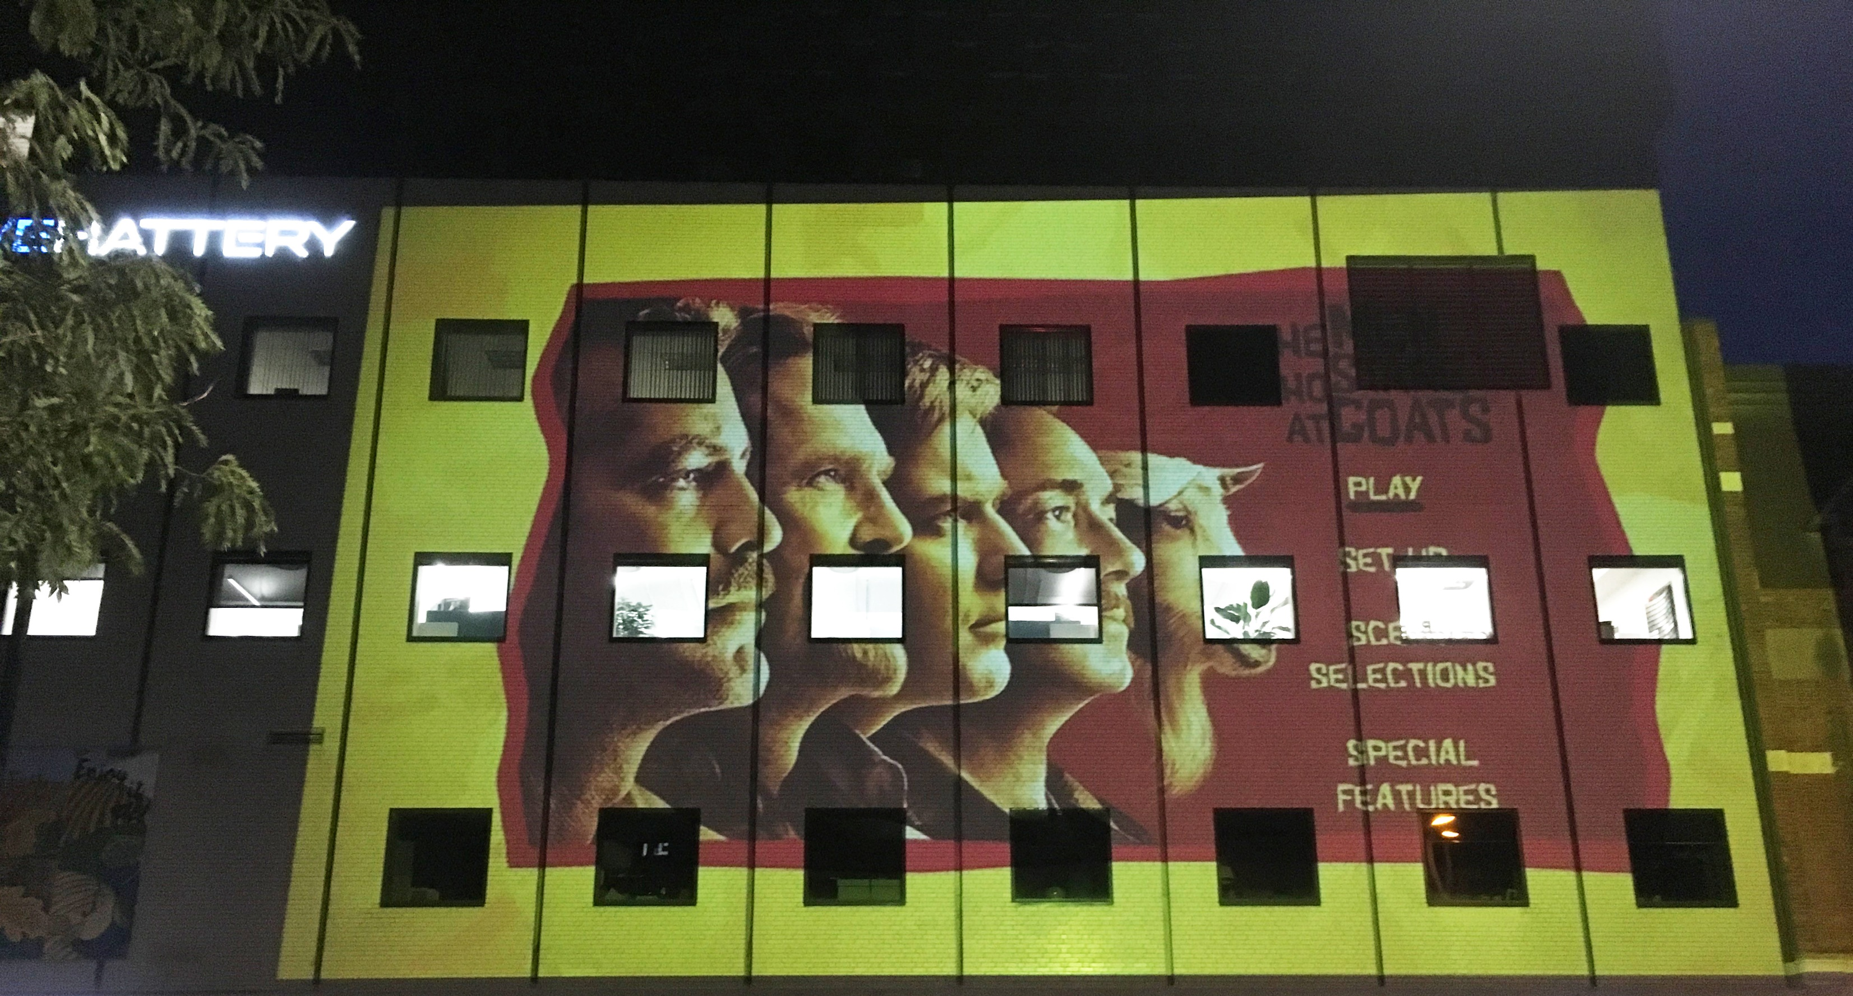
Plans
2021
Armstrong Center/ 3rd & 3rd
High tech projector installed on 3rd Avenue
Display light art images and eventually events onto the south facing side of the Armstrong Center

Slide 12
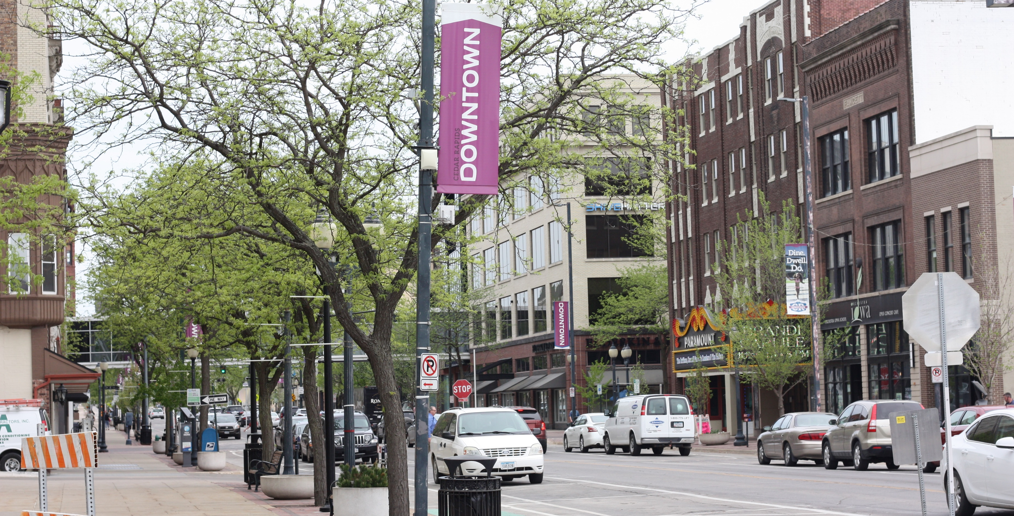
Plans
2021
Future of Commercial Real Estate
in Core Districts
Featuring MetLife VP of Real Estate Research & Strategy (former CR resident) and Oxford Professor/International Economist Daniel Susskind
Delve into how Downtown and greater ICR region can confront challenges and seize opportunities that arise in the wake of the pandemic

Slide 13
Plans
2021
Downtown Art in 2021
Adcraft building on 3rd Street: Theme of community spirit; work slated to commence with local artist team in April
2nd Avenue Parking Ramp: ConnectCR-themed; world renown artist duo the NeverCrew (selected by the City’s VAC) scheduled to begin work late summer
Downtown/MedQ boundary (specific location in works): theme of celebrating our local health care heroes during pandemic
Fix Salon: mural on wall facing Dash slated to begin in June

Slide 14
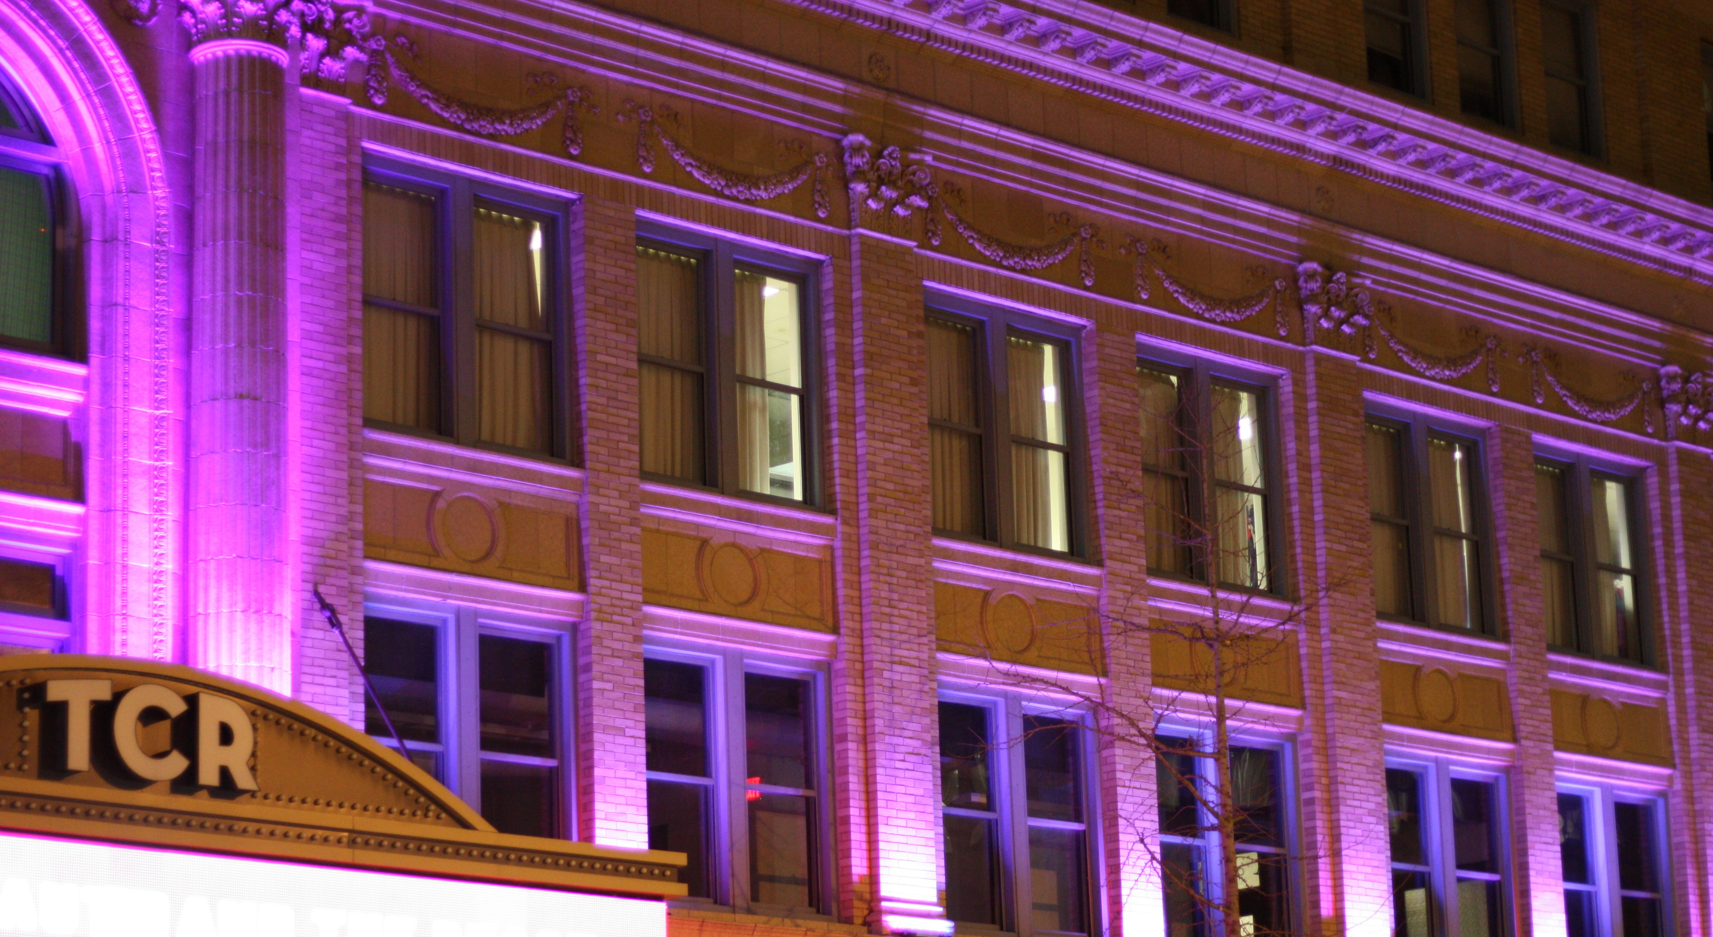
Plans
2021
Façade Improvements
Grant program has seen a surge in use over the past few weeks
Illumination projects with CRBT and Cedar River Tower
New marquee project with TCR
Building entrance project with FIX Salon

Slide 15
Thank You

